Slide 1
CORRELATION BETWEEN COVID-19 AND MOBILITY IN ITALY

Slide 2



Hello!
Team members for group project:
Fiordeponti Giovanni
Ionta Antonio
Marchiori Silvia
Notes:
This is us

Slide 3
Abstract
Presenting a Visual Analytics environment regarding the effects of the CoVid-19 pandemic in Italy, during the year 2020.
Addressing the correlation between the pandemic aggressiveness trend and the variation of mobility of the population.

Slide 4
Has the lockdown be effective to reduce the contagion?
Is there a direct connection with an increment in people’s movement?

Slide 5
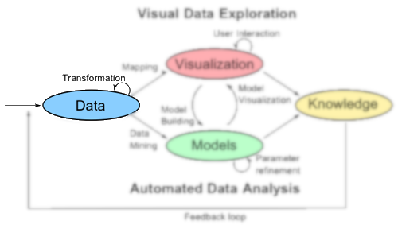
DATA

Slide 6
Datasets
CoVid-19 Italy Data
Information about the pandemic’s severity in Italy, day by day.
Offered by the Italian Department of Civil Protection.
License CC-BY-4.0.
Positives
New cases
Death
Healed
Hospitalized
Isolated
Intensive care
CoVid-19 Community Mobility Reports
Movement trends by region, across different categories of places. For each category in a region, reports show the changes comparing mobility for the report date to the baseline day, reported as a positive or negative percentage.
Offered by Google.
Groceries-Pharmacy
Parks
Residential
Retail-Recreation
Transit
A subset of the data enclosed in these sources were selected and, through an activity of pre-processing, were aggregated (spatiotemporal coordinates as join condition) into a single CSV file feeding the visualization.

Slide 7
~6300 records
12 dimensions
~75600 AS index
21 regions * 30 days * 10 months
6300 tuples * 12 attributes

Slide 8
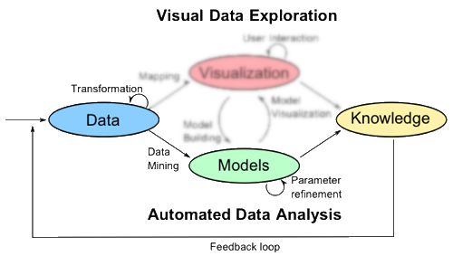
MODEL

Slide 9
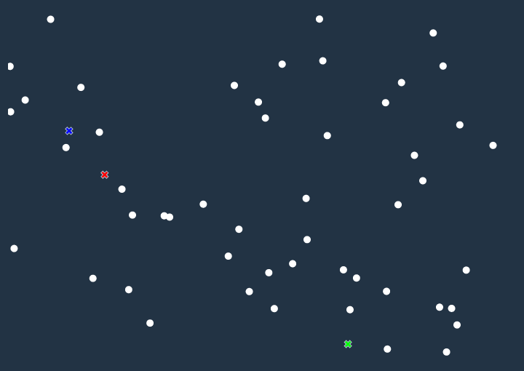
Looking for Correlation
Dimensionality Reduction: t-SNE
Application of the non-linear transformation of t-SNE to the input dataset.
Obtaining a two-dimensional representation of the data, where similarities can be visually highlighted.
Clustering: K-Means
Notes:
Correlation between CoVid-19 data and Mobility data.
Relationships between data items in the multidimensional space: clusters, trends, outliers, etc. Proximity ←→ Similarity. Mapping R^{n} → R².
t-SNE + K-Means, tuning K.
Non-linear transformation. Similarities ←→ Distances as conditional probabilities. Minimizing stress function. Both false positives and false negatives.
Amplifies separation among data ←→ around density. Highlighting clusters.
Well-known, fast. Criticality: #classes. Tuning with visual feedback ←→ best surfaces of separation.

Slide 10
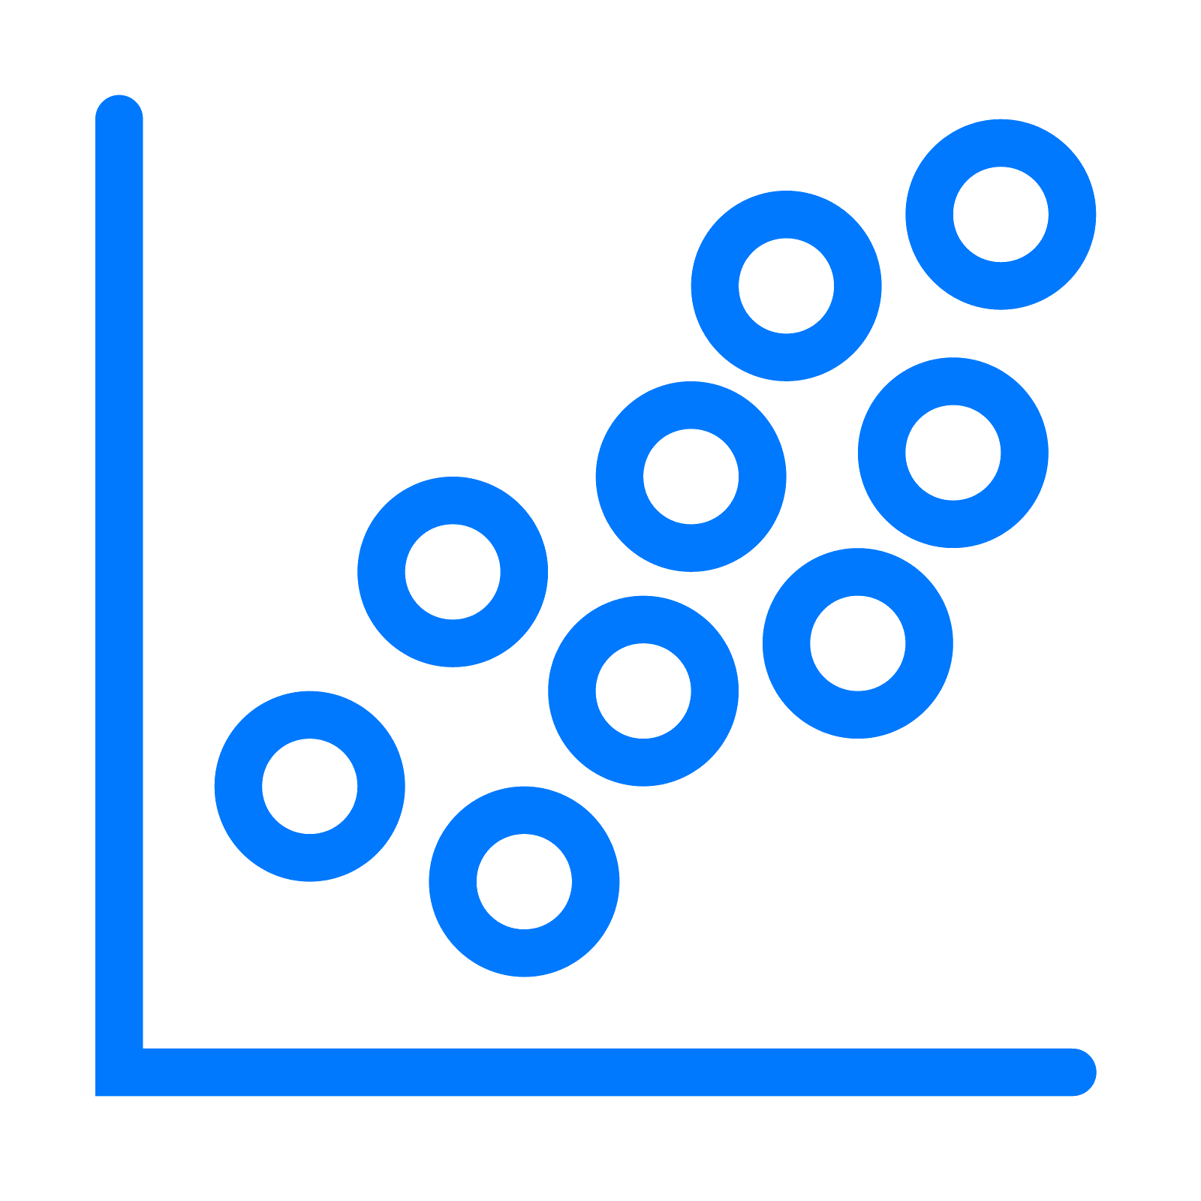





Analytics on Demand
POST
JSON
Notes:
Back-end service. Deployed on application server (pythonanywhere). Continuously listening. RESTful paradigm. Python + Flask. sklearn.

Slide 11
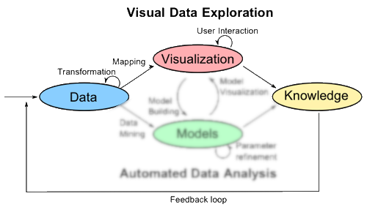
VISUALIZATION

Slide 12
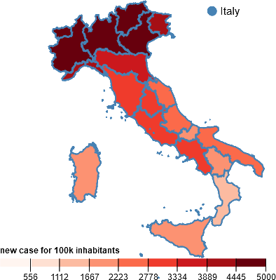
Choropleth Map
Illustrates the spread of the pandemic across the country.
Why?
Show cases wrt population
Select different regions

Slide 13
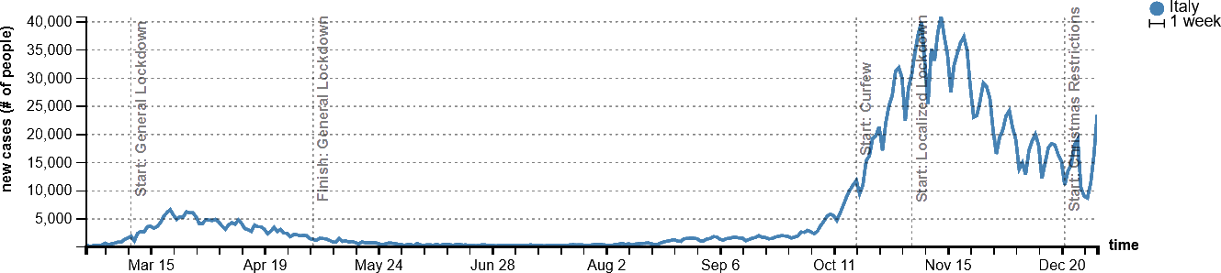
Time Series
Shows the evolution of the pandemic during the year wrt different parameters.
Why?
Restrict data to a give range
Compare different regions

Slide 14
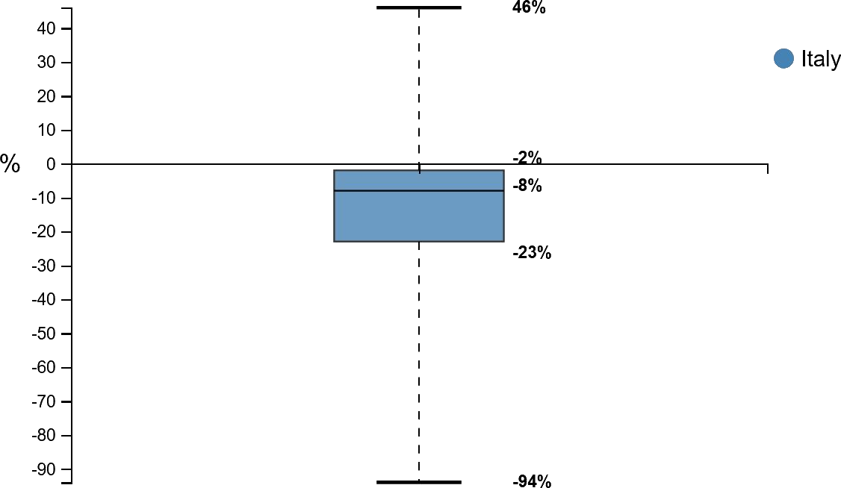
Boxplot
Represents the mobility data of the selected regions.
Why?
Mobility as statistic order
Time independant

Slide 15
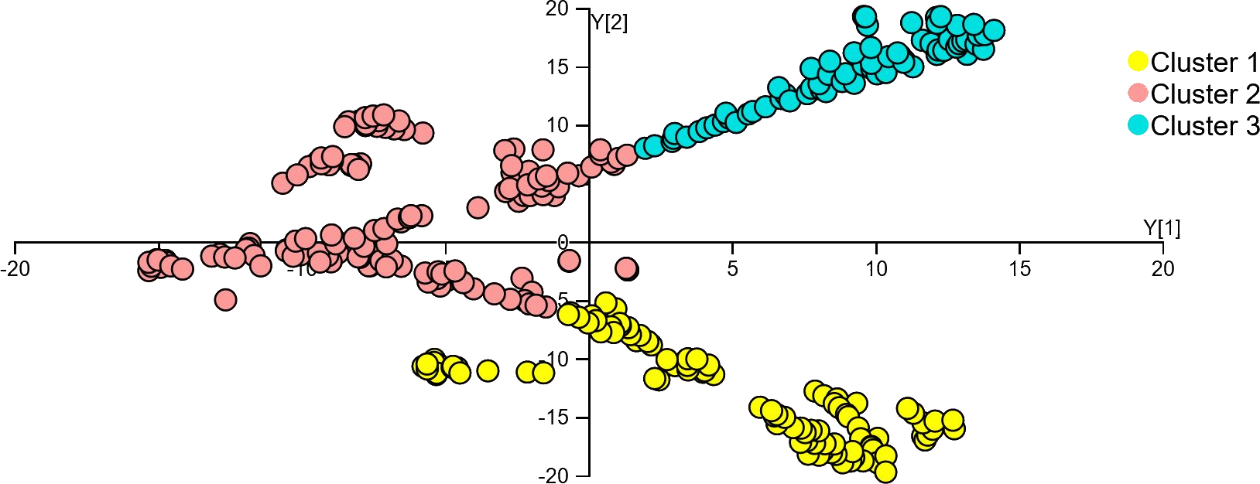
Scatter Plot
Results of dimensionality reduction and clustering
Why?
Correlation between pandemic’s trend and mobility
Address regions similarities
Show national trends

Slide 16
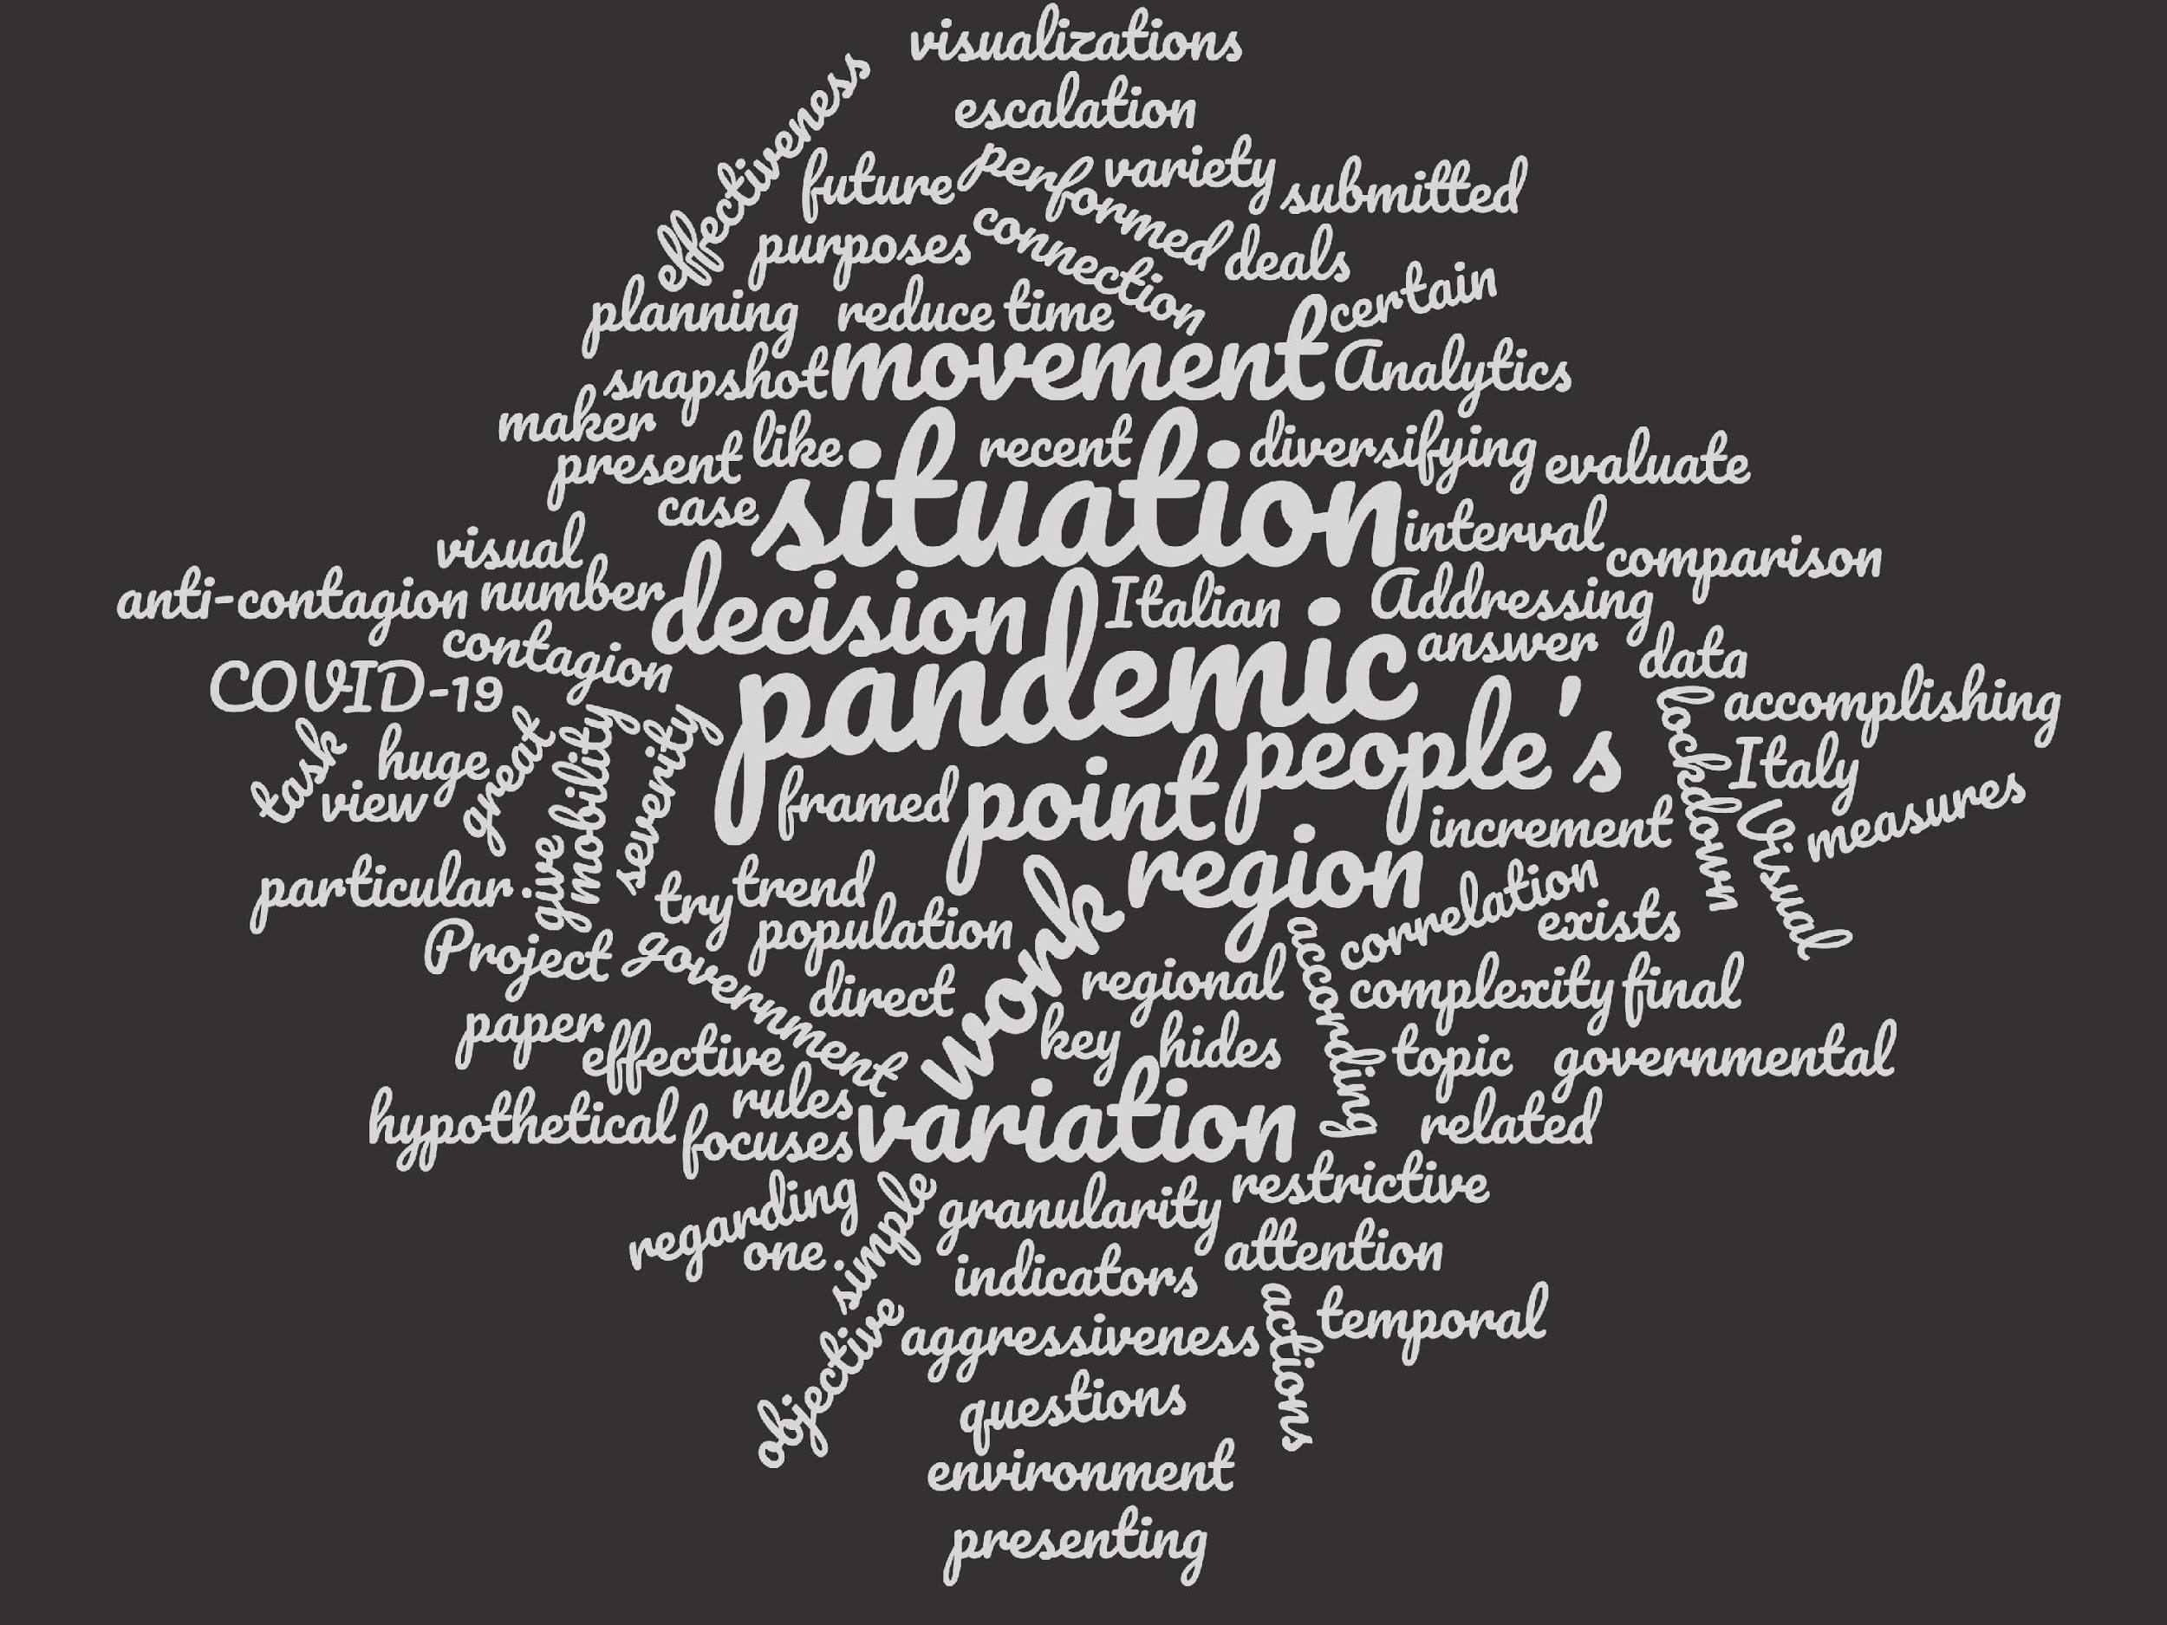
RELATED WORKS

Slide 17
How can this work be located with respect to existing literature about similar topics?

Slide 18
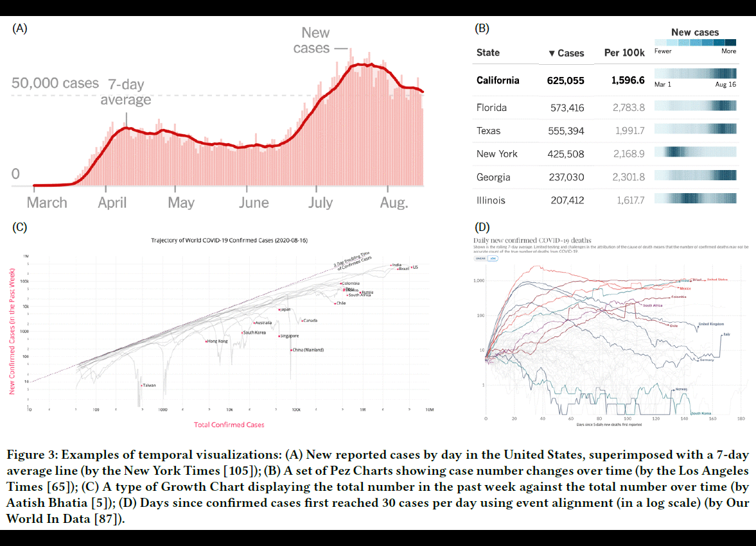
[ZSPBBP]

Slide 19
[ZSPBBP]
Proposes a huge panoramic of CoVid-19 crisis visualizations, analyzing a corpus of works on the topic.
What is similar?
Purpose of communication
Visualizations for informing the severity of the pandemic
Geospatial visualizations
What is different?
Target user
Lesson learned
Non-ambiguous, almost familiar, visual environment concerning CoVid-19 data
Color-coding normalized data
Avoid simplifications
Data source reporting

Slide 20
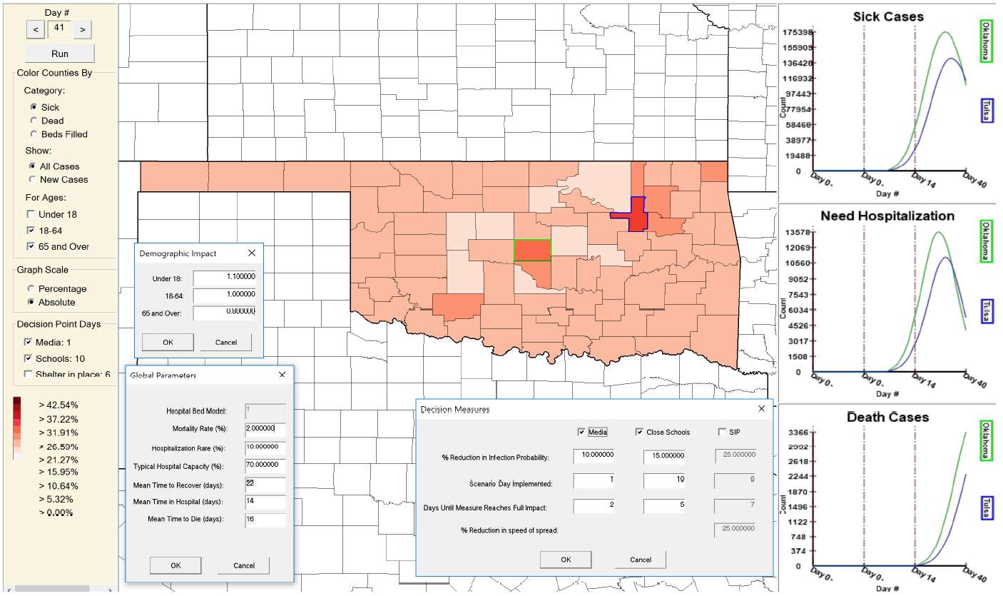
[AGSEHH]
Notes:
Shares target. Support to decision-maker user.
Shares visual components. Multiple linked views: geospatial map + timeseries.
Main distinction: analytics. Predicting model – Simulation inherent to the effect that hypothetic restrictive measures might have in a certain context. More restricted focus. Less parameters, standard methods. Looking ahead VS looking back.
Planned extension: incorporate additional datasets like connectivity information (road networks and google maps traffic datasets) to adjust the spatial dynamics.

Slide 21
[AGSEHH]
Provides an environment to facilitate CoVid-19 modeling, exploration and visualization for offering support to decision-maker user.
What is similar?
Target user and main purpose
Visual components for describing virus trends
What is different?
Analytics
Lesson learned
Mobility as parameter at stake
Notes:
Shares target. Support to decision-maker user.
Shares visual components. Multiple linked views: geospatial map + timeseries.
Main distinction: analytics. Predicting model – Simulation inherent to the effect that hypothetic restrictive measures might have in a certain context. More restricted focus. Less parameters, standard methods. Looking ahead VS looking back.
Planned extension: incorporate additional datasets like connectivity information (road networks and google maps traffic datasets) to adjust the spatial dynamics.

Slide 22
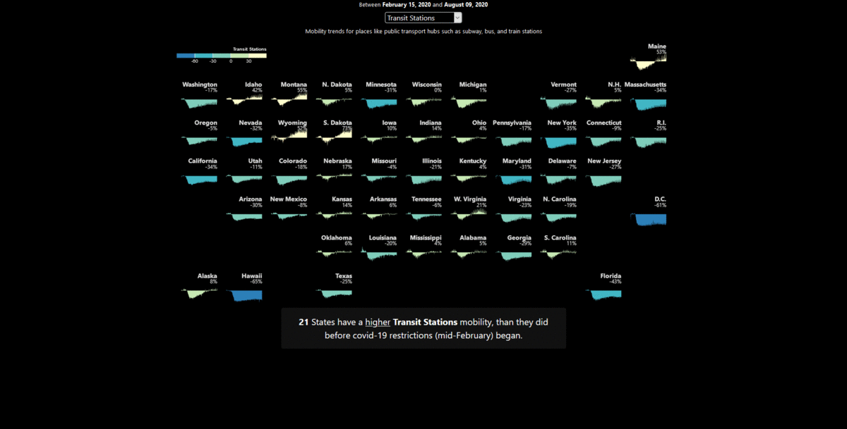
[VARDHAN]

Slide 23
[VARDHAN]
Measures people’s movement before and during the COVID-19 with a visualization in the form of scrollytelling in tandem with tile grid maps.
What is similar?
Google Mobility dataset
What is different?
Lack of analytics
Lesson learned
Presenting results engaging users

Slide 24

Conclusions and Future Works

Slide 25
The End
This project tried to offer a visual environment of support for verifying the effectiveness of the main anti-COVID measure, social distancing, in Italy
Cues for future works:
Growth Chart
Story-telling
Correlation with other kinds of data
Notes:
Visual environment of support for verifying the effectiveness of the main anti-COVID measure, social distancing. Reasoning from the perspective of a user involved in governmental decisions.
Small subset of cues for future refinements.
Growth Chart. Total number of the confirmed cases as the x-axis and the weekly confirmed cases as the y-axis. Log scale to both axes, total case number as the x-axis (rather than time) helps reveal trends and patterns.
Engaging story-telling. Complementary visual environment.
How further the Visual Analytics can be integrated with the public health official context to be of help for preparing and exercising response plans in pandemic outbreak scenarios. Exploring deeper the correlation between pandemics trends and other kinds of data.

Slide 26
References
[ZSPBBP] Yixuan Zhang, Yifan Sun, Lace Padilla, Sumit Barua, Enrico Bertini, and Andrea G. Parker. 2021. Mapping the Landscape of COVID-19 Crisis Visualizations. In CHI Conference on Human Factors in Computing Systems (CHI ’21), May 8–13, 2021, Yokohama, Japan. ACM, New York, NY, USA, 23 pages. https://doi.org/10.1145/3411764.3445381
[AGSEHH] S. Afzal, S. Ghani, H. C. Jenkins-Smith, D. S. Ebert, M. Hadwiger and I. Hoteit, "A Visual Analytics Based Decision Making Environment for COVID-19 Modeling and Visualization," 2020 IEEE Visualization Conference (VIS), Salt Lake City, UT, USA, 2020, pp. 86-90, doi: 10.1109/VIS47514.2020.00024.
[VARDHAN] Vardhan, P. (2020, August 28). Tile Narrative: Scrollytelling with Grid Maps In Visualization for Communication (VisComm). https://doi.org/10.31219/osf.io/xr64m

Slide 27

Thanks!
Share ideas and get involved!
Visit the GitHub page of the project

